Slide 1
Employee Data Analysis using Excel
STUDENT NAME : K.SRIHARI
REGISTER NO : 312205366
NAAN MUDHALVAN ID : asunm285b22319
DEPARTMENT : B.com commerce
COLLEGE : Sridevi arts and science college

Slide 2
PROJECT TITLE
Emplyee Attrition Analysis Using Excel Dashboards

Slide 3


AGENDA
Problem Statement
Project Overview
End Users
Our Solution and Proposition
Dataset Description
Modelling Approach
Results and Discussion
Conclusion
3/21/2024 Annual Review

Slide 4

PROBLEM STATEMENT
An employee attrition report can include information about the rate at which employees leave an organization, and how this rate can affect the company

Slide 5

PROJECT OVERVIEW
Employee attrition report is a key HR metric that tracks the rate at which employees leave a company over a set period of time. It’s expressed as a percentage and can help HR teams understand how to improve retention efforts and workforce planning.

Slide 6

WHO ARE THE END USERS?
EMPLOYEES
EMPLOYERS
CUSTOMERS
HR TEAMS

Slide 7

OUR SOLUTION AND ITS VALUE PROPOSITION
1. LINE CHART: Highlighting years with above average attrition: A line chart can be used to highlight years with above average attrition.
2. PIVOT TABLE: It is a tool that helps you analyze and summarize large amounts of data.
3. CONDITIONAL FORMATTING: It can be used in Excel to highlight patterns and trends in a salary sheet.

Slide 8
Dataset Description
EMPLOYEE ATTRITION REPORT – Kaggle
Features
Opening count
New joiners
Exit employees
Remaining employees
Average number of employees
Attrtion

Slide 9

THE "WOW" IN OUR SOLUTION
Exit attributes
Average no of employees
Attrition %
3/21/2024 Annual Review
9

Slide 10
MODELLING
Data Collection
Data cleaning
Techniques
Formulas
Results
Pivot table
Line chart
10

Slide 11
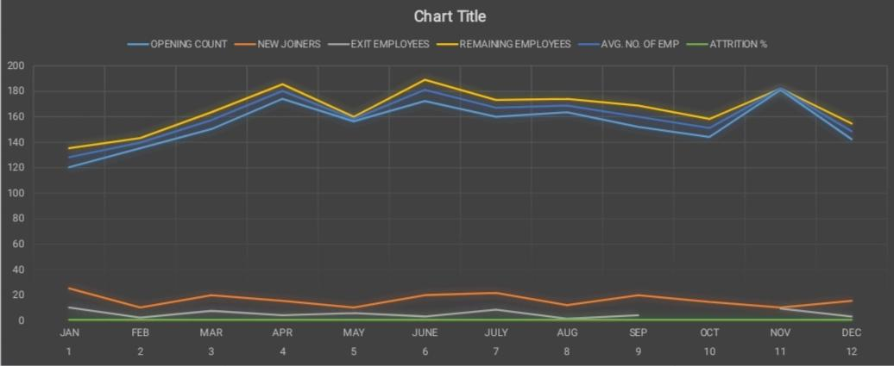
RESULTS
11

Slide 12
conclusion
Employee attrition is a critical aspect of HRM that impacts an organization's stability and success. By understanding its definition, examples, types, and implications, businesses can proactively address attrition and create a work environment that retains valuable talent.

